Slide 1
Machine Learning Project Death in 5 years prediction
By Stav Rahamim & Tal Rosner

Slide 2
Presentation Summary
Introduction and approach
Data preprocessing – main features conclusions
Unsupervised learning
Supervised learning
Models measure methods & accuracy
Conclusions

Slide 3
Introduction and approach
Year | Population | Death count | Death rate
2011 | 1,952,624 | 1704 | 0.0873%
2012 | 1,990,188 | 1699 | 0.0854%
2013 | 2,030,785 | 1694 | 0.0834%
2014 | 2,070,562 | 1733 | 0.0837%
2015 | 2,110,721 | 1697 | 0.0804%
2016 | 2,150,096 | 1798 | 0.0836%
2017 | 2,191,646 | 1780 | 0.0812%
2018 | 2,229,702 | 1770 | 0.0794%
Our data | 12,438 | 197 | 1.5839%
According to the Central Bureau of Statistics the data we are dealing with have high death rate.
We decided to use unsupervised learning to classify the risk groups. Unsupervised learning allows us to automatically identify patterns in the data and classify them into risk groups. This is a more efficient way of dealing with data that has a large rate of sick people, as it requires less manual intervention.

Slide 4
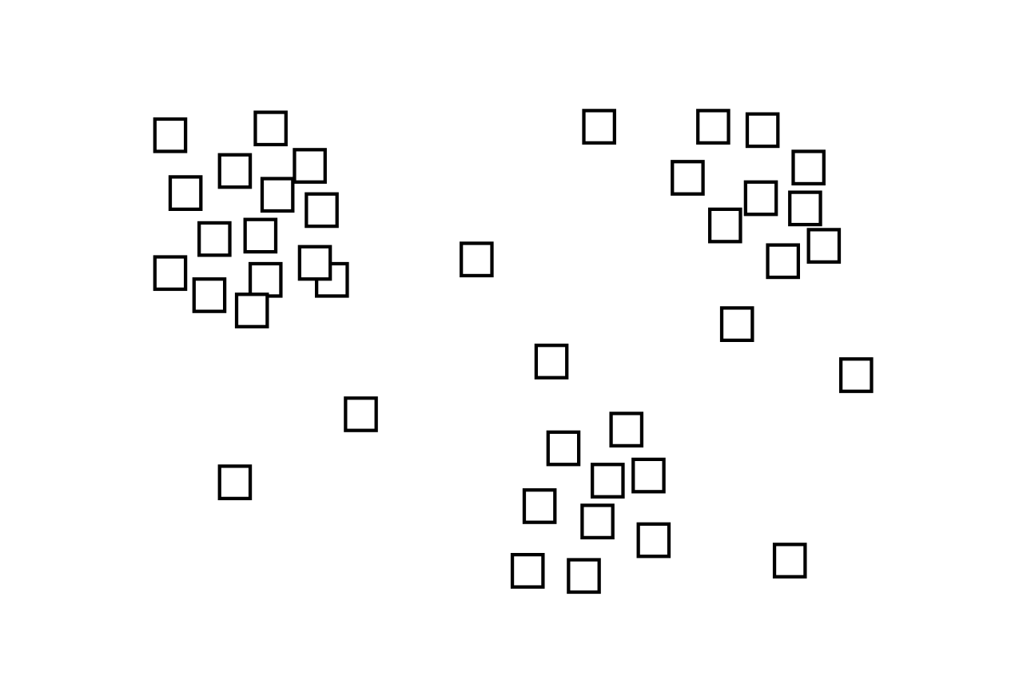

Supervised VS Unsupervised

Slide 5
Data preprocessing
Null including features
Categorical features (strings)
Dimensions reduction using correlative features
Normalize
Data balancing

Slide 6
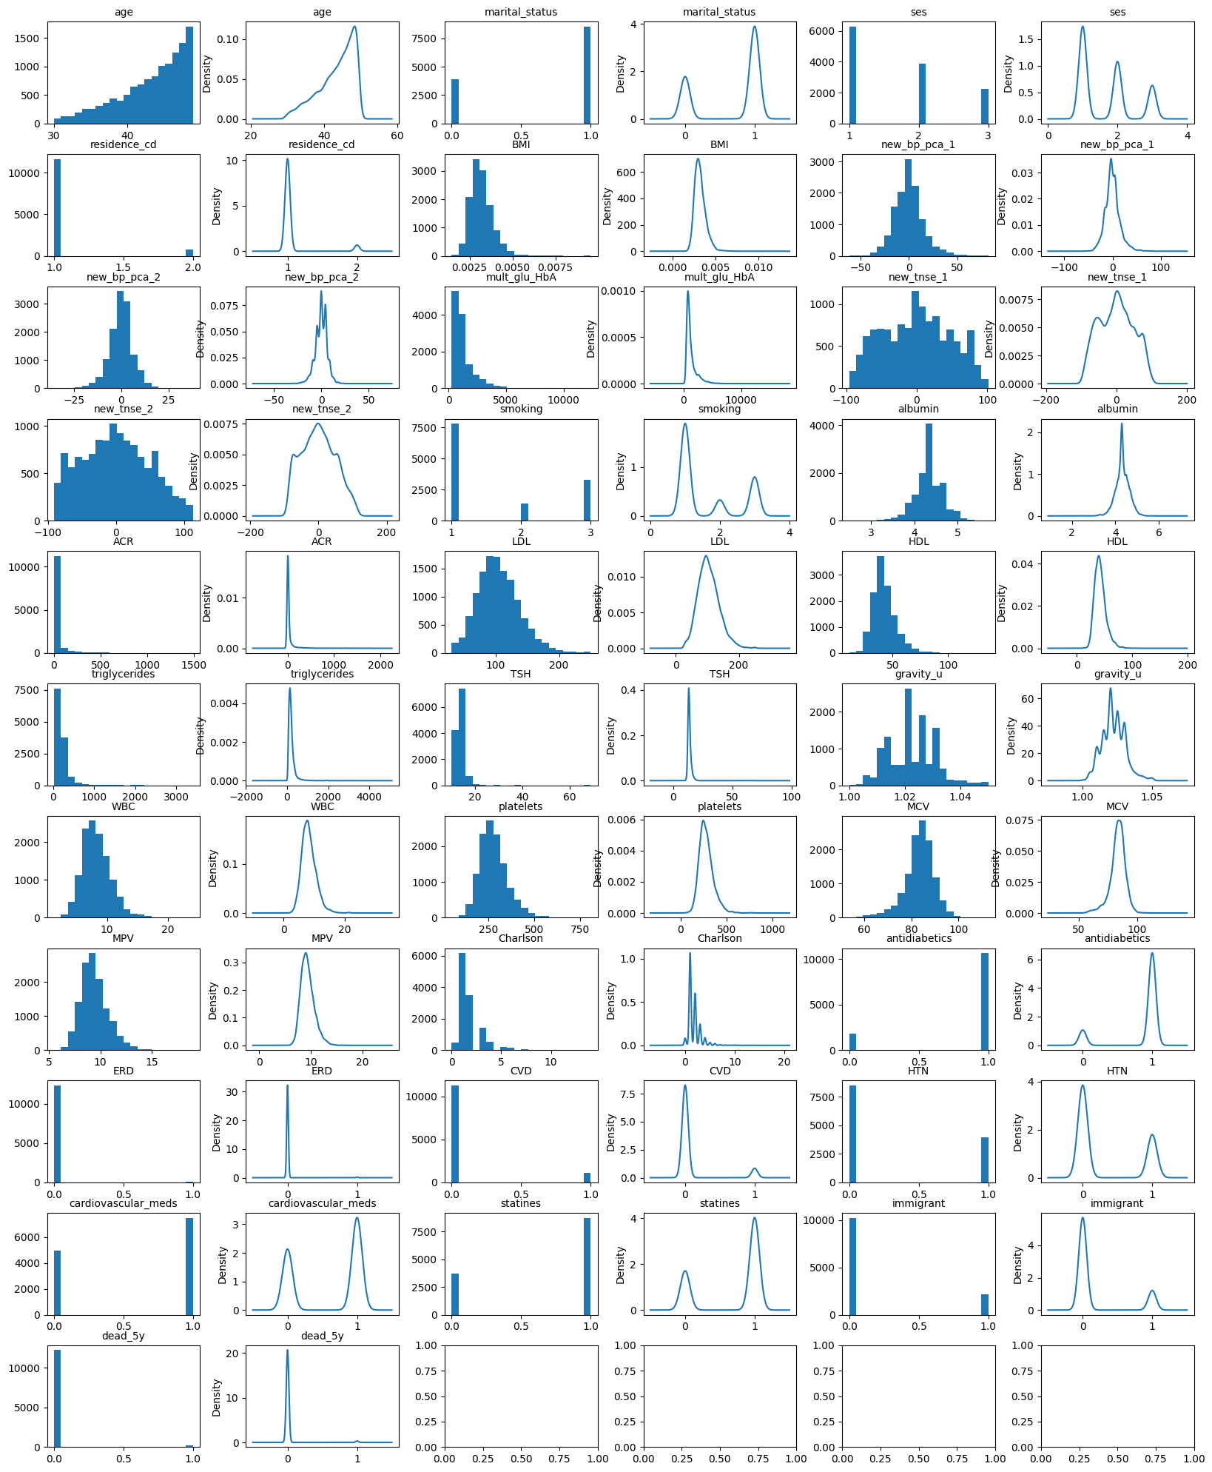

Slide 7
Null including features
Discover features
Visualize distribution
Value count
Summary of the central tendency, dispersion and shape of a dataset’s distribution
Histogram and density estimation
Finding the null rate in each feature contains null
Feature removing
More than 50% nulls
More than 50% zeros
Feature filling
The density estimation like normal – we filled with the median because it is noise insensitive
Fill the previous values for non normal like density estimation

Slide 8
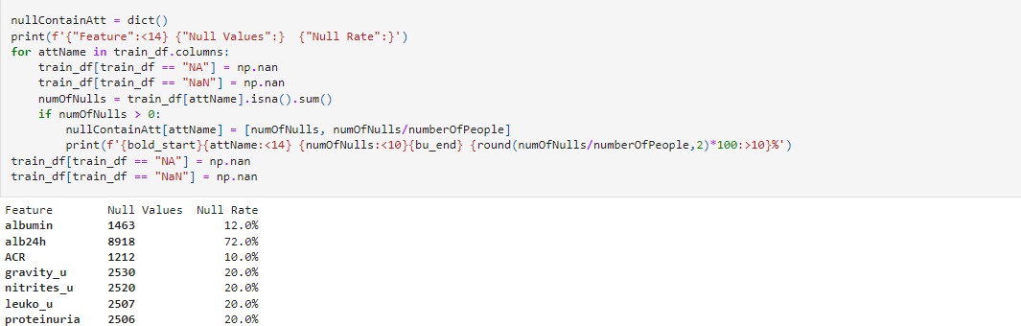
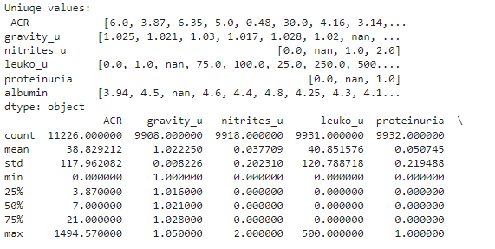
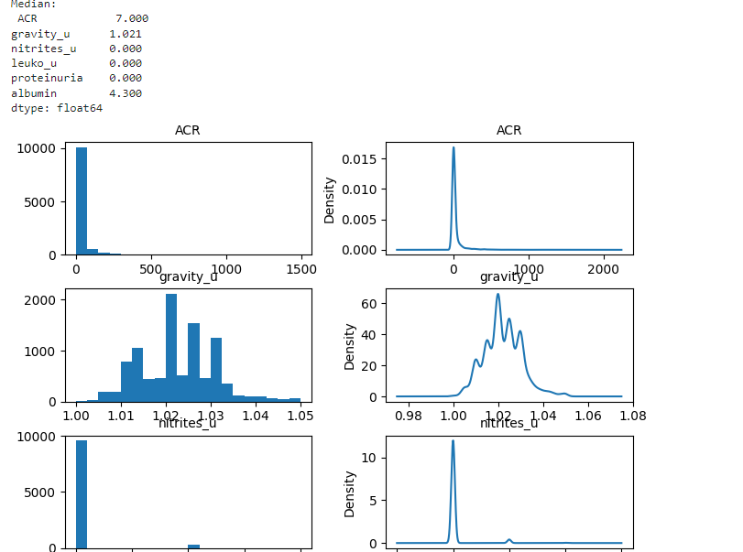
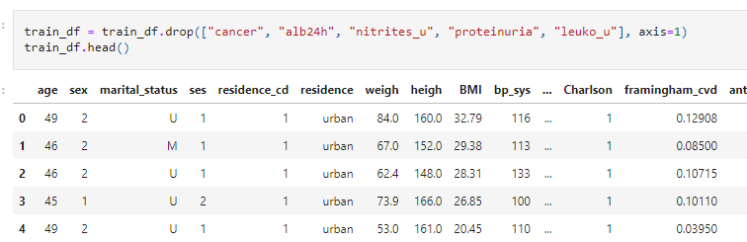
Discover features
Visualize distribution
Feature removing
Feature filling

Slide 9
Categorical features
Discover features
Look for numerical discrete mapping
Looking for features that have the same information but in numerical form
Finding the string contain features
Convert to numerical
Understand what are the feature unique values.
Binary features will map into {0,1}
Ordered categories will map into discrete numbers from 1 to N groups

Slide 10
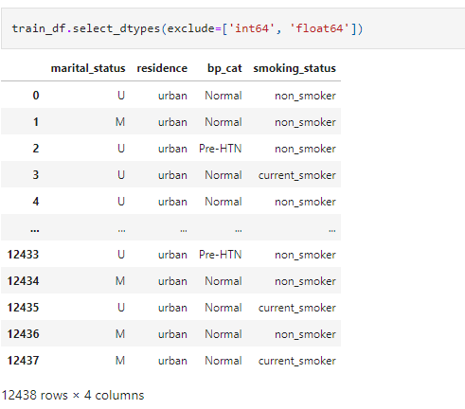
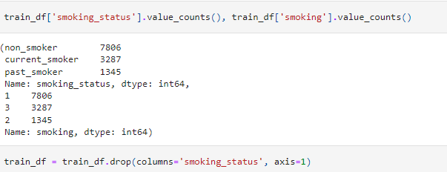
Discover features
Look for numerical discrete mapping
Convert to numerical

Slide 11
Dimensions reduction using correlative features

Slide 12
Correlation matrices
Pearson
Spearman
Measures the linear association between two variables and is calculated as the covariance of the two variables divided by the product of their standard deviations.
Used for continuous feature
-1 to 1 range. -1: perfect negative linear relationship 0: no linear relationship 1: perfect positive linear relationship.
Rank-based measure of association and is calculated as the Pearson correlation between the ranks of the two variables. It is used when the relationship between the two variables is not linear.
Used when the data is ordinal or has outliers
-1 to 1 range. -1: perfect negative monotonic relationship 0: no monotonic relationship 1: perfect positive monotonic relationship.

Slide 13
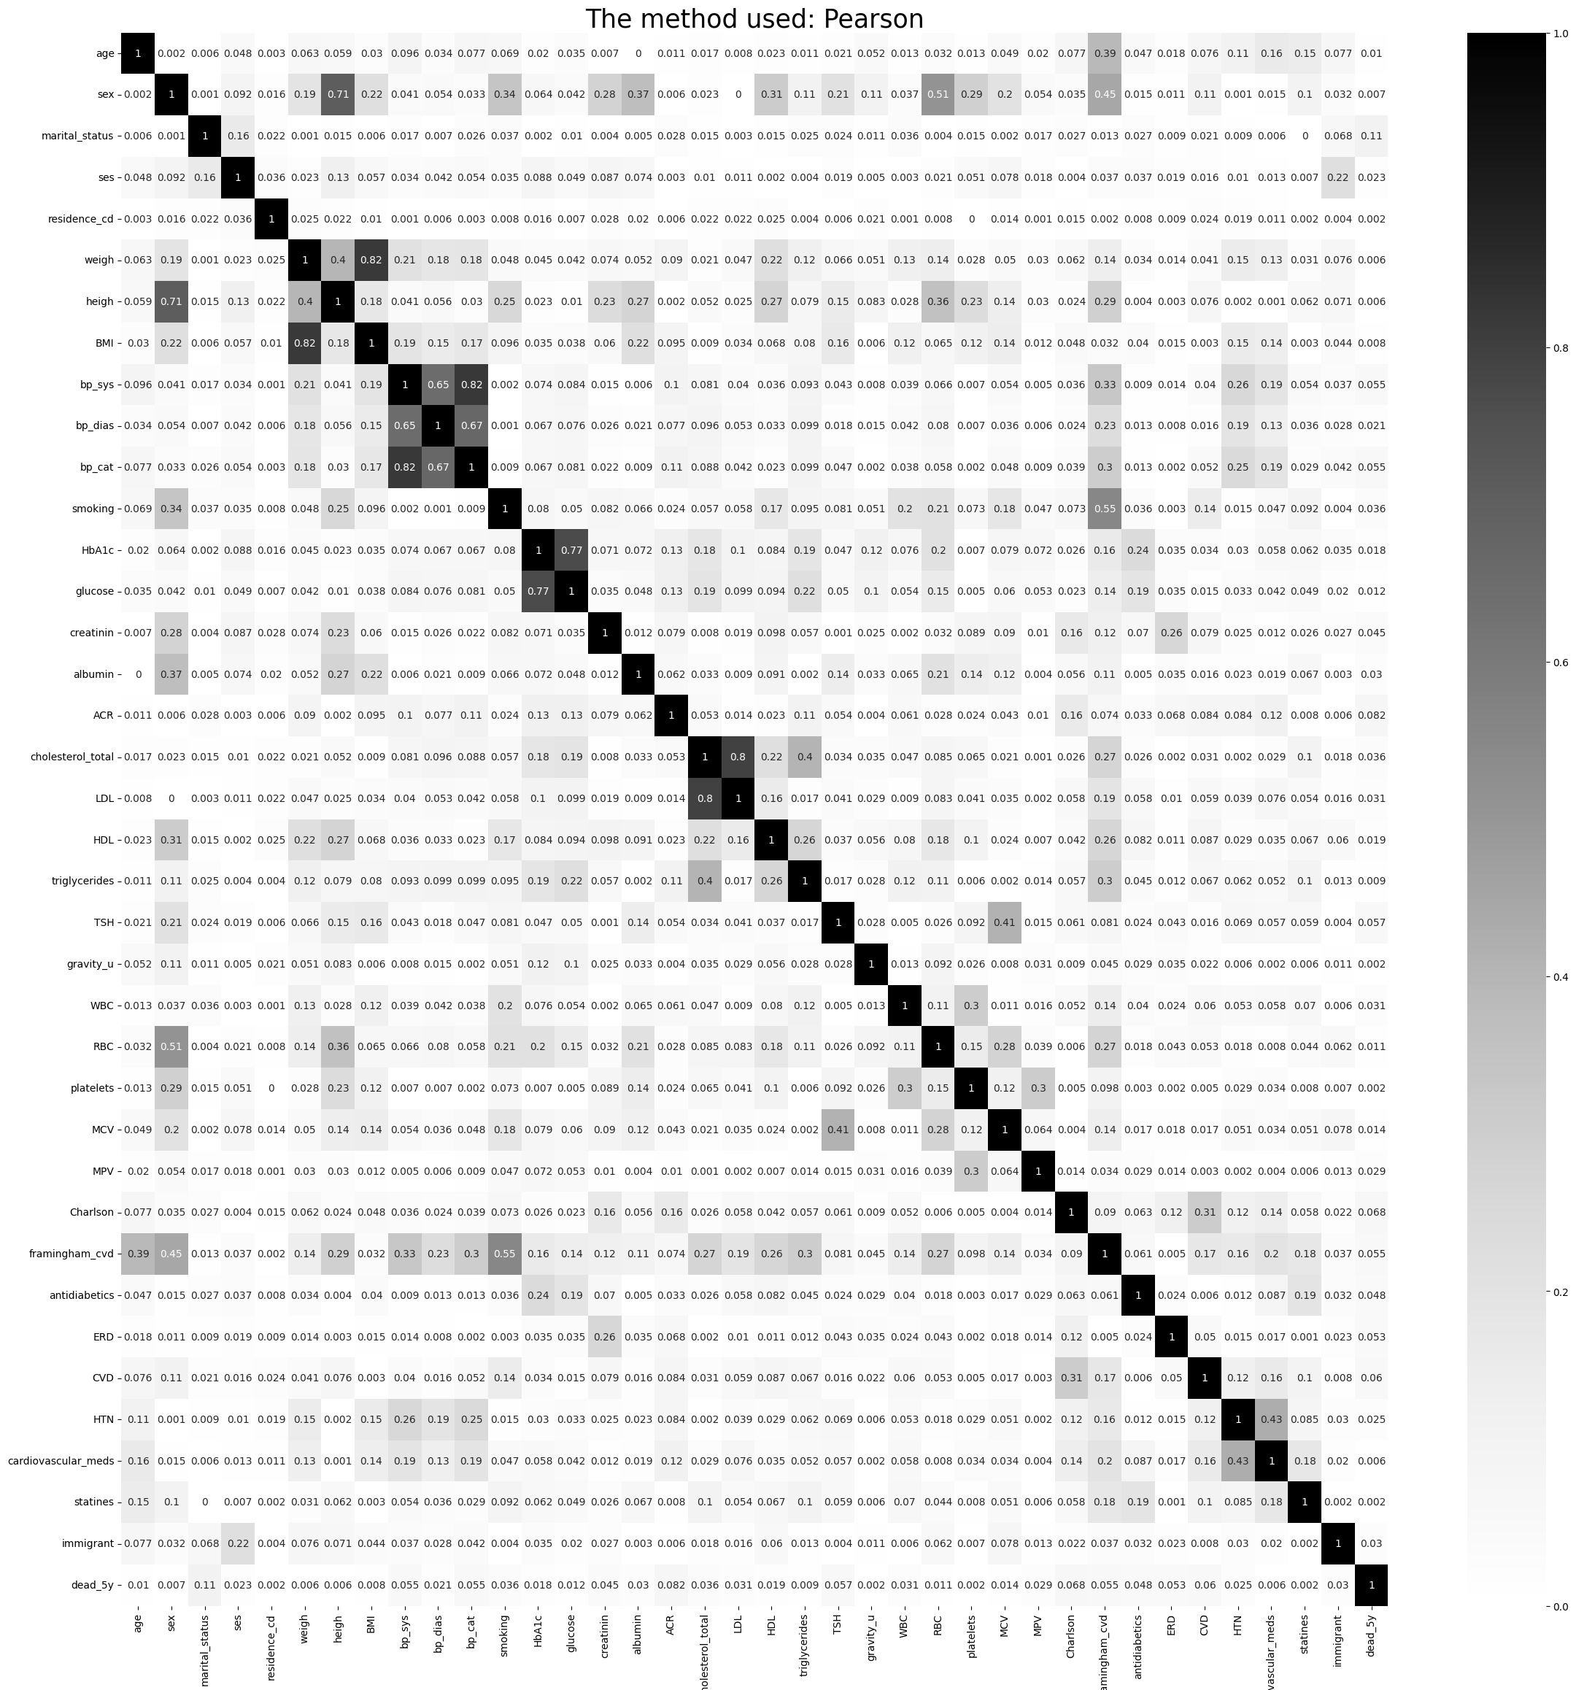
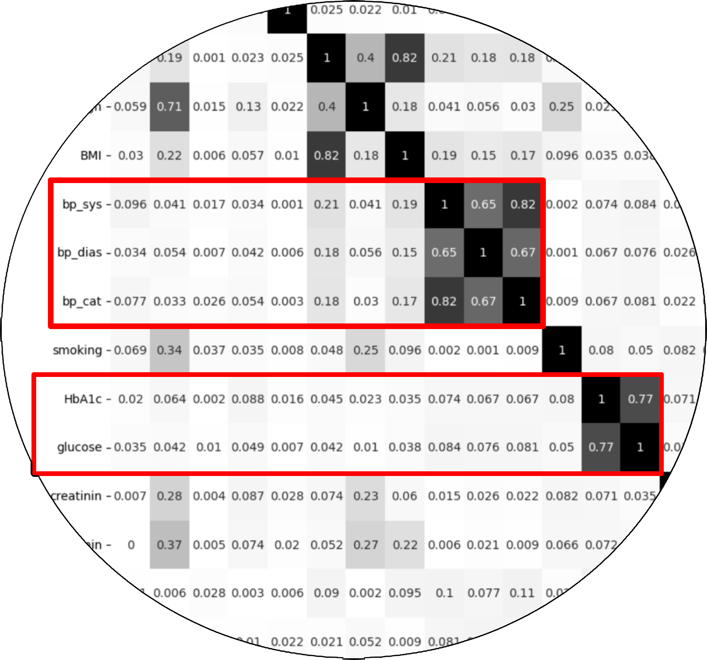

Slide 14
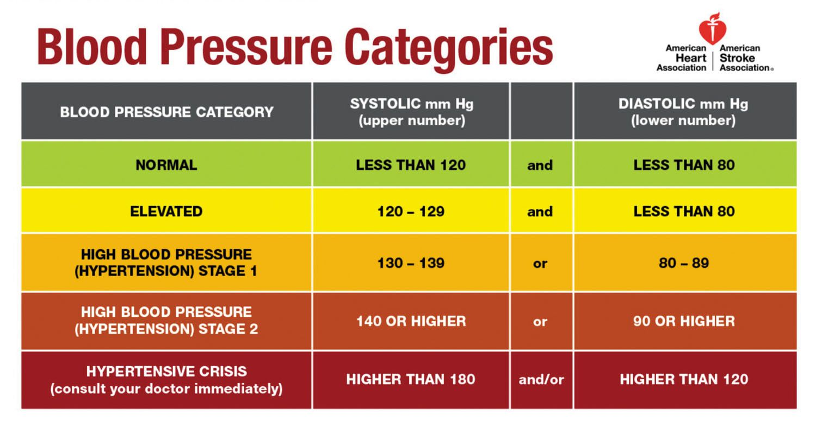
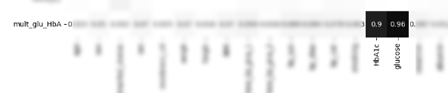
Continuous Dimension Reduction examples
BP features: we can see high correlation between `bp_sys`, `bp_dias` and `bp_cat`.
Why we used PCA:
Dimension reduction – less features == less computing power.
Creating new two orthogonal features – the new features have no correlation.
Trail and Error: `glucose` and `HbA1c` features have 0.77 correlation rate, by using trail and error approach we found out that multiply those features correlates well with both features and we can drop both and use the new feature

Slide 15
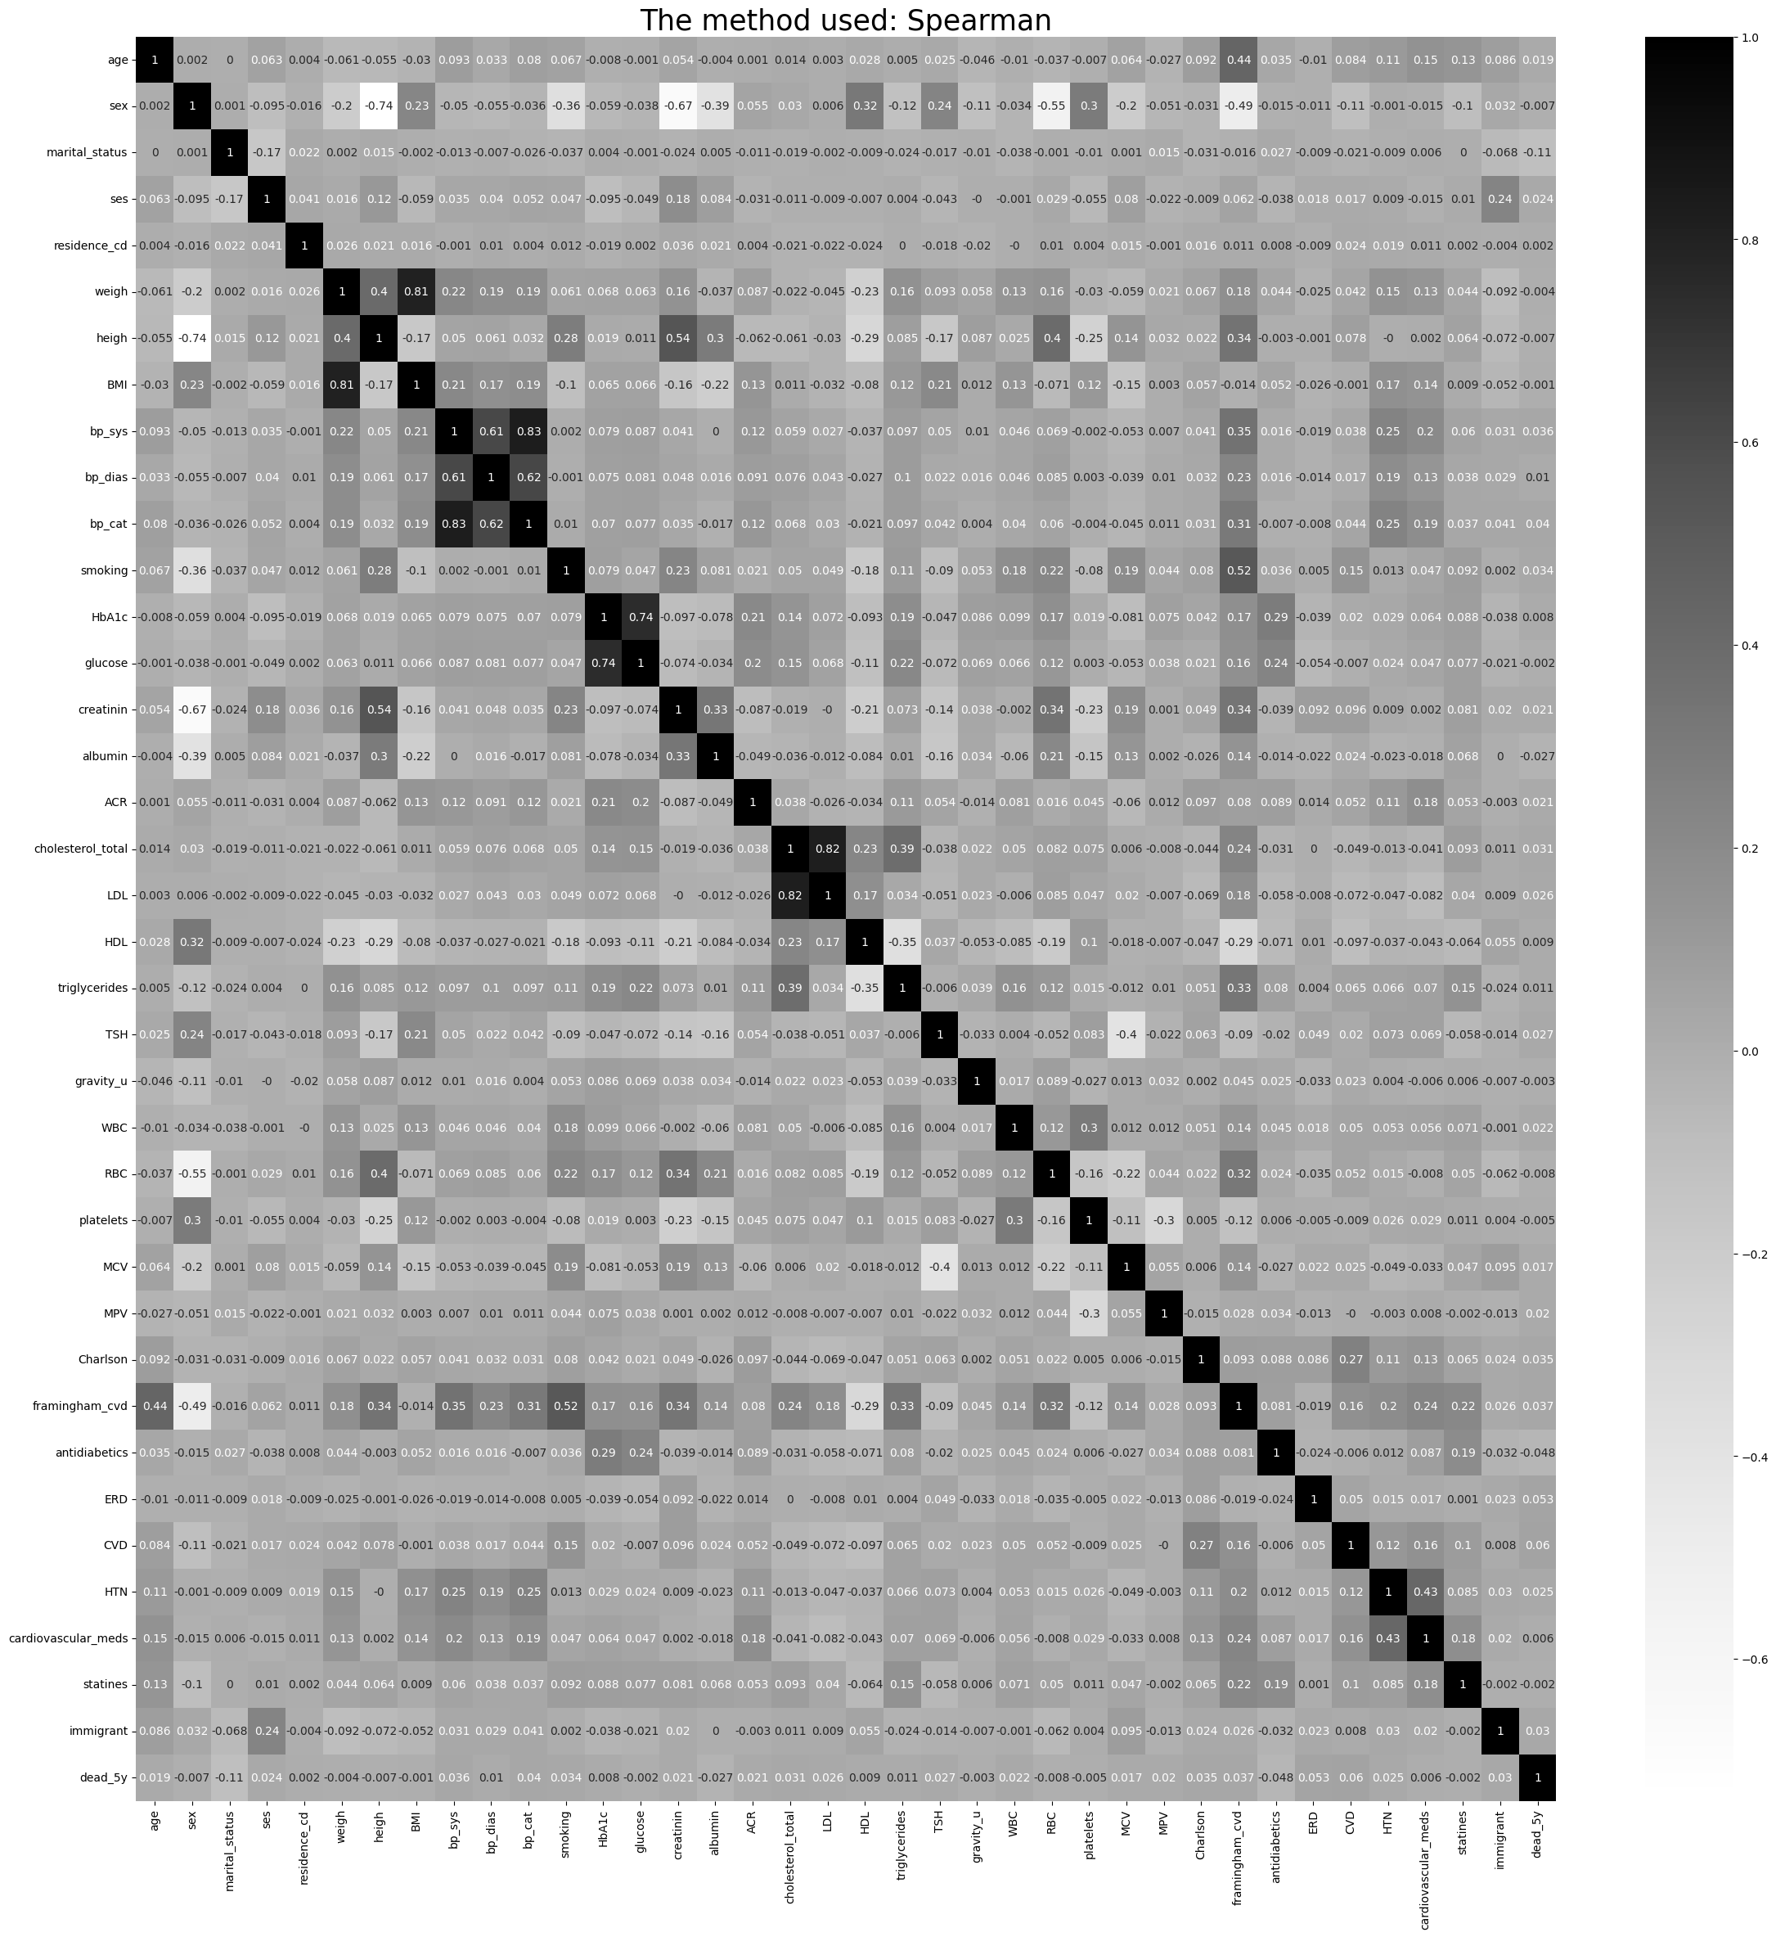
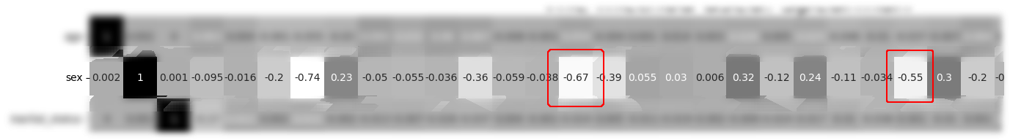
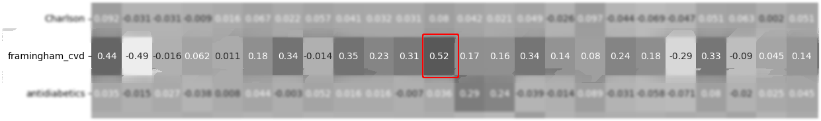
creatinin
RBC
Smoking

Slide 16
District Dimension Reduction examples
TSNE (t-distributed Stochastic Neighbor Embedding):
Compute pairwise similarities - calculate the pairwise similarities between all data points in the high-dimensional space. This can be done using a similarity measure such as the Euclidean or Gaussian kernel.
Initialize the low-dimensional representation - The next step is to randomly initialize the low-dimensional representation of the data points. This is typically done in a 2D or 3D plot.
Optimize the cost function - The main objective of t-SNE is to minimize a cost function that measures the difference between the pairwise similarities in the high-dimensional space and the pairwise similarities in the low-dimensional space. The cost function is optimized using gradient descent or similar optimization techniques.
Compute the low-dimensional representation - After the cost function is minimized, the final low-dimensional representation of the data is obtained. This representation can then be plotted in a 2D or 3D scatter plot to visualize the relationships between the data points.

Slide 17
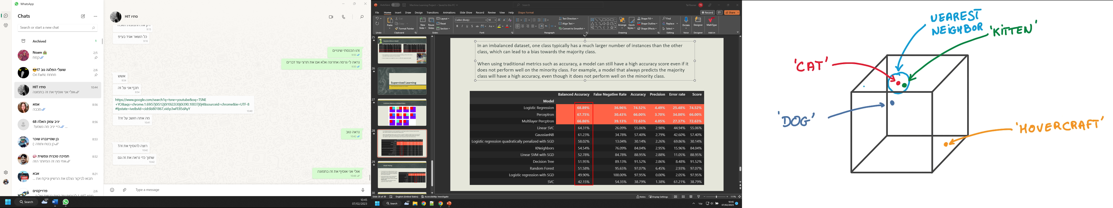
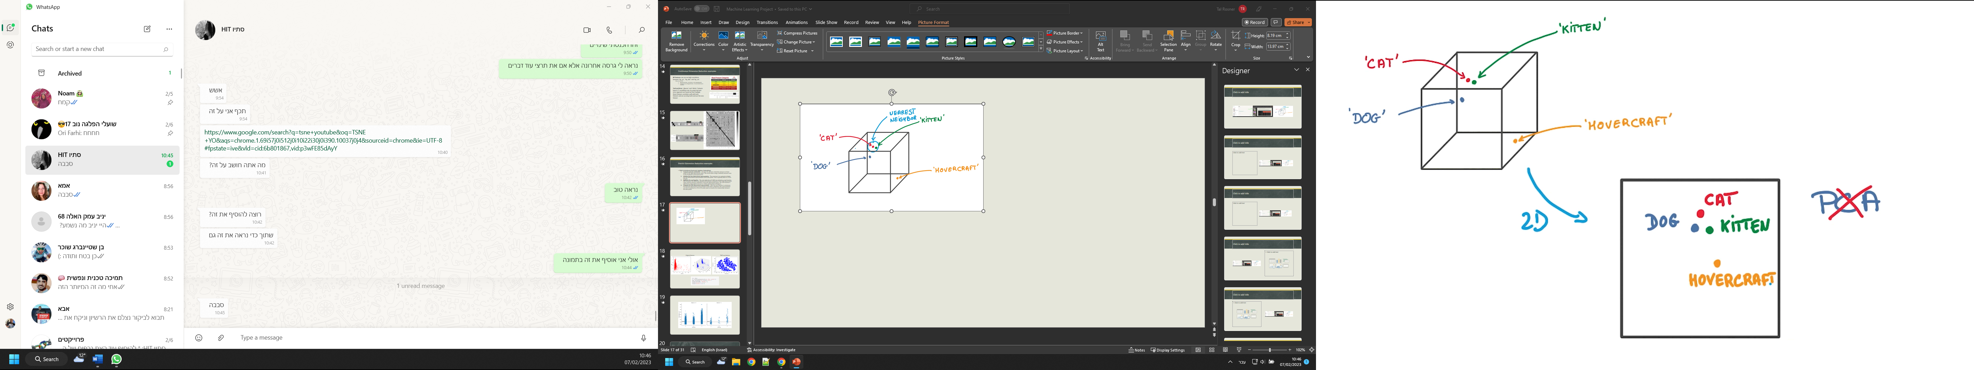
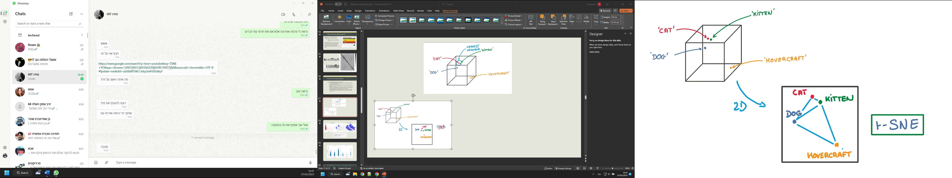

Slide 18
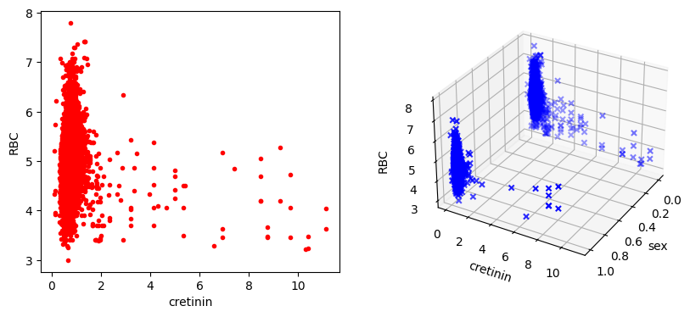
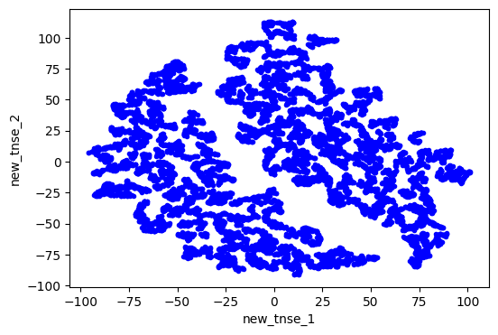
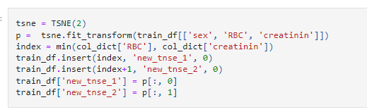
Original features
TNSE new features

Slide 19
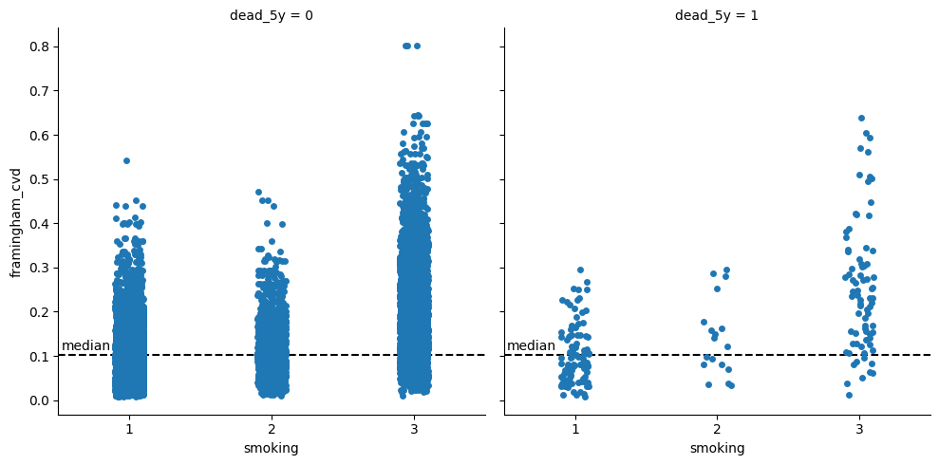

Slide 20
Normalization

Slide 21
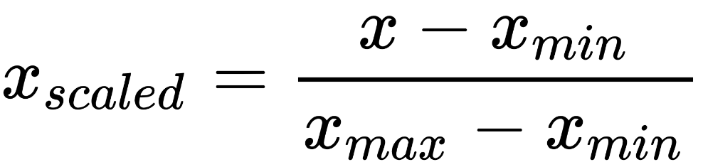
Min-Max Normalization
Also referred as Feature Scaling, performs linear transformation on the data.
This technique gets all the scaled data in the range (0, 1).
Disadvantage: Does not handle outliers very well. For example: if you have 99 values between 0 and 40, and one value is 100, then the 99 values will all be transformed to a value between 0 and 0.4. That data is just as squished as before!
We used the method for normal distribution like features.
Formula:

Slide 22
Data Balancing

Slide 23
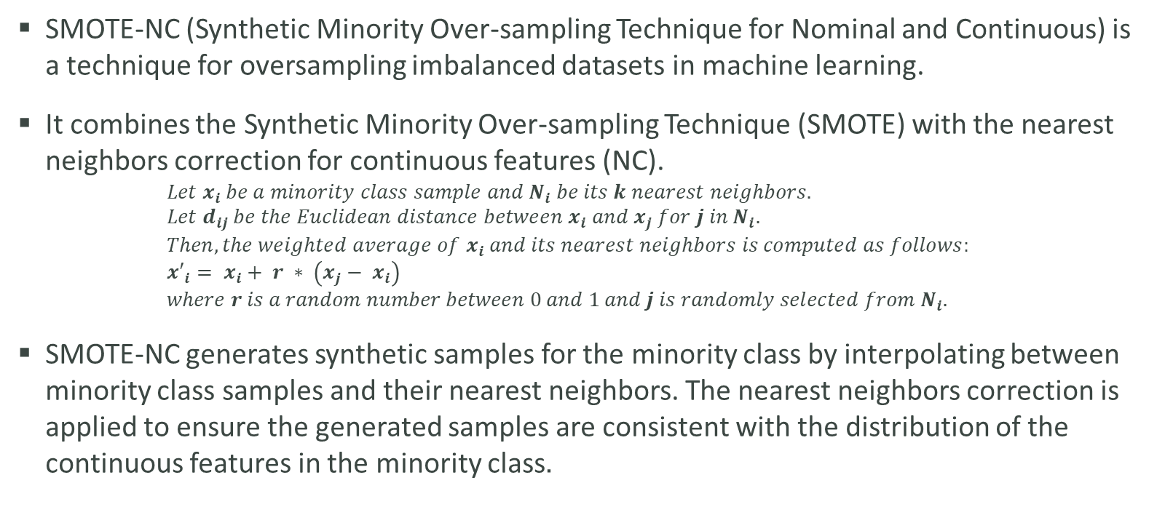
SMOTE-NC
SMOTE-NC (Synthetic Minority Over-sampling Technique for Nominal and Continuous) is a technique for oversampling imbalanced datasets in machine learning.
It combines the Synthetic Minority Over-sampling Technique (SMOTE) with the nearest neighbors correction for continuous features (NC). $Let x_{i} be a minority class sample and N_{i} be its k nearest neighbors.$ $Let d_{ij} be the Euclidean distance between x_{i} and x_{j} for j in N_{i}.$ $Then, the weighted average of x_{i} and its nearest neighbors is computed as follows:$ $x′_{i}= x_{i}+ r ∗ \left(x_{j}− x_{i}\right)$ $where r is a random number between 0 and 1 and j is randomly selected from N_{i}.$
SMOTE-NC generates synthetic samples for the minority class by interpolating between minority class samples and their nearest neighbors. The nearest neighbors correction is applied to ensure the generated samples are consistent with the distribution of the continuous features in the minority class.

Slide 24
Unsupervised Learning
Cluster our data into risk groups before the supervised learning

Slide 25
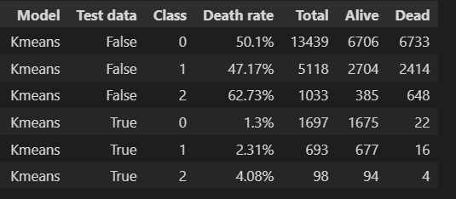
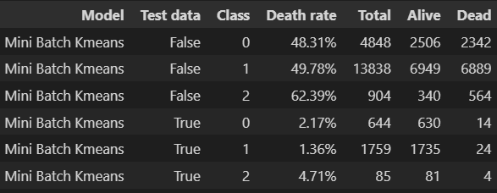
K Means & Mini Batch K Means
We can easily notice that both models created new risk group with much higher risk than the other and the original data.
It seems like a good direction, so we tested some more models, the following model works best form our perspective.

Slide 26
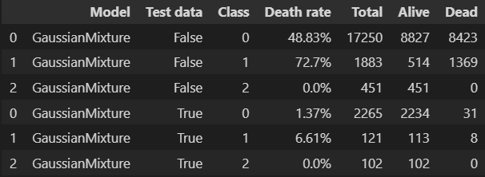
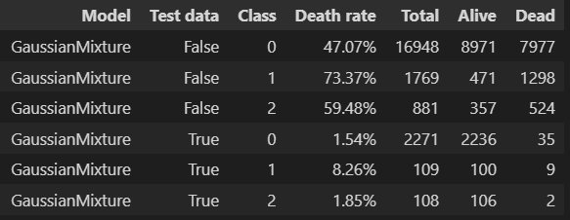
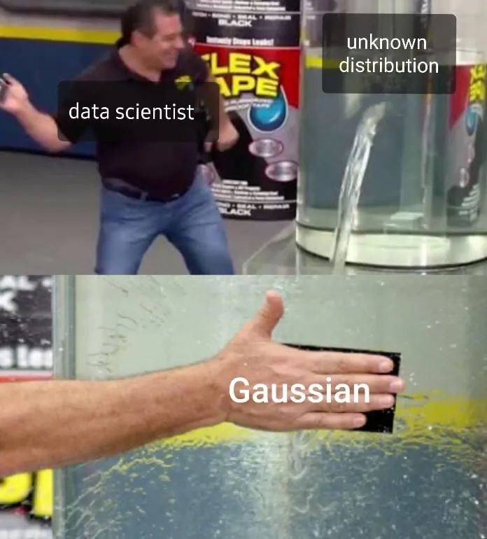

Gaussian Mixture Model
The model give us more accurate risk group dividing, we’ll use the classes that GMM made and insert it into the data.
We are trying to use weight for classes to affect the supervised model.

Slide 27
Supervised Learning
How should we choose our model?

Slide 28
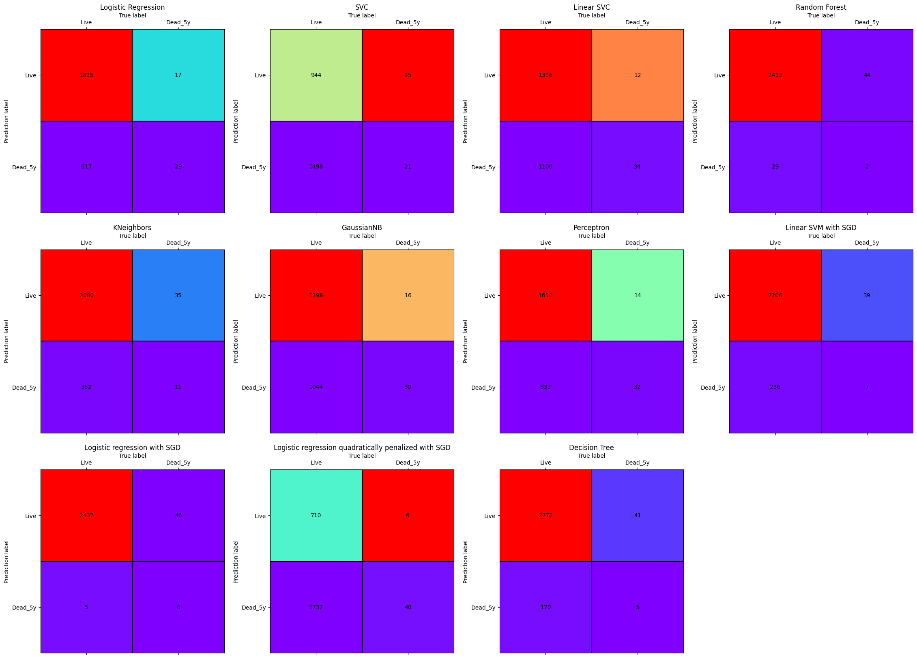
Confusion Matrices & Related Rates

Slide 29
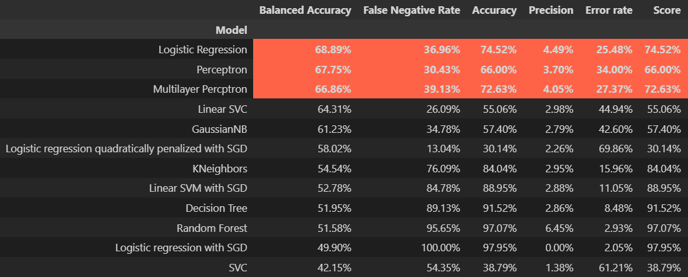
In an imbalanced dataset, one class typically has a much larger number of instances than the other class, which can lead to a bias towards the majority class.
When using traditional metrics such as accuracy, a model can still have a high accuracy score even if it does not perform well on the minority class. For example, a model that always predicts the majority class will have a high accuracy, even though it does not perform well on the minority class.

Slide 30

Model Picking
If we look from an unbiased point of view, we should use the model with the highest balanced accuracy, therefore we’ll get the best result for any data.
On the other hand, we are testing death prediction in 5 years, taking this into consider should maybe measure the False Negative Rate. It can show how many dead in 5 years people the model “missed”.

Slide 31
Conclusions
Imbalanced data provides a lot of difficulties that we must chose a road along the way, it can be a waste of time in some cases.
In our case the we can notice the tradeoffs in the models and keep it in mind while considering what should we use.
For future work we should create a new model that will optimize the following Min-Max problem:
Minimize the false negative rate
Maximize the balanced accuracy

